Slide 1
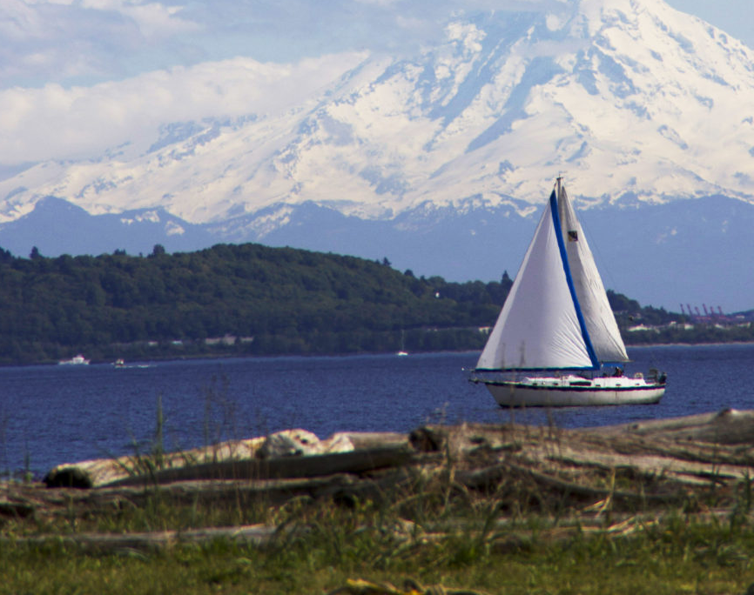
MOFFAT BAY PROJECT BELLEVUE UNIVERSITY CSD 460 CAPSTONE
Joel Avery
Andrew Danielson
Tabark Kambal
Gabriel Pedraza Torres
10 DECEMBER 2023

Slide 2
Team Introduction
Joel Avery

Slide 3
Team Introduction
Andrew Danielson
Married 17 years
Five Children – Four boys and one girl; ages from 15 to 3(girl)
Active Duty USAF (17.5 years of service)
Currently stationed in Germany at Spangdahlem Air Base
Has had the same job the entire time Munitions Systems
I ensure that USAF aircraft can do their specific missions and do it safely
I build bombs 💣
Earned two Associate of Applied Science degrees
Munitions Systems Technology – Community College of the Air Force
Electronics Technology – College of Western Idaho

Slide 4
Team Introduction
Tabark Kambal

Slide 5
Team Introduction
Gabriel Pedraza Torres

Slide 6
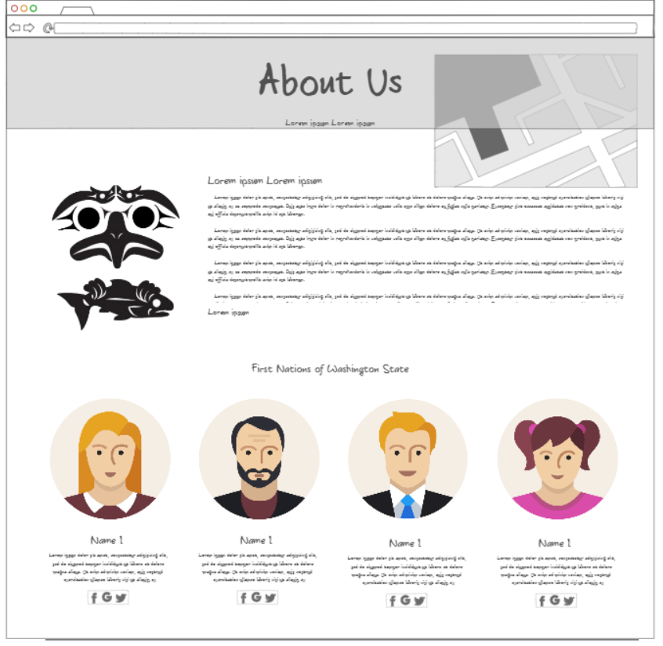
Prototypes and Mock-ups
About Us page
Similar layout, but still is different.
Added link to First Nations website.

Slide 7
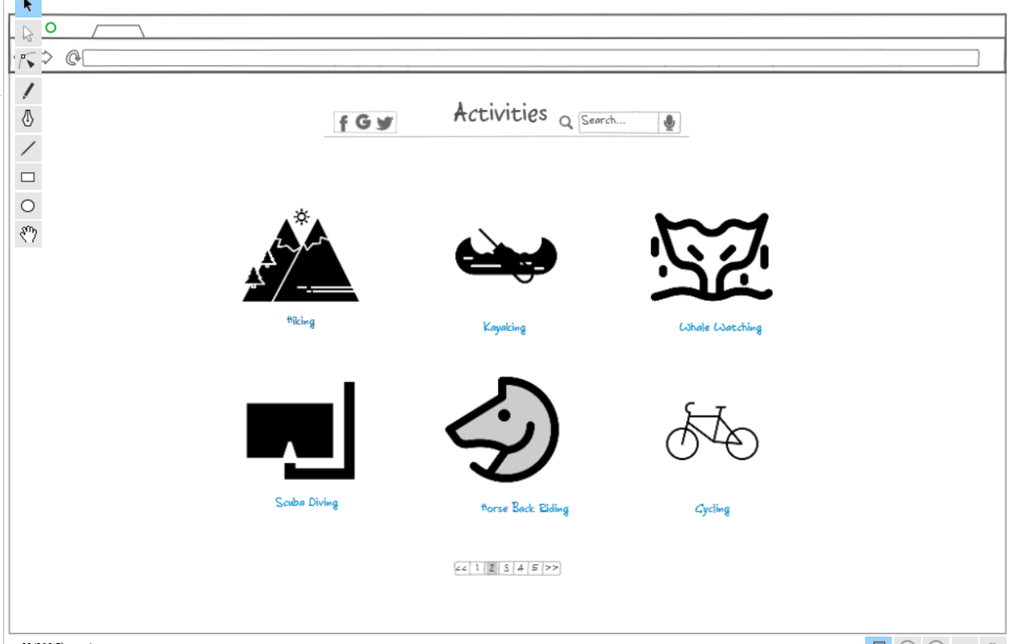
Prototypes and Mock-ups
Mock-up for the Moffat Bay Lodge Activities Page.
Initial had one container with multiple images
Live page, did not end up looking like this.

Slide 8
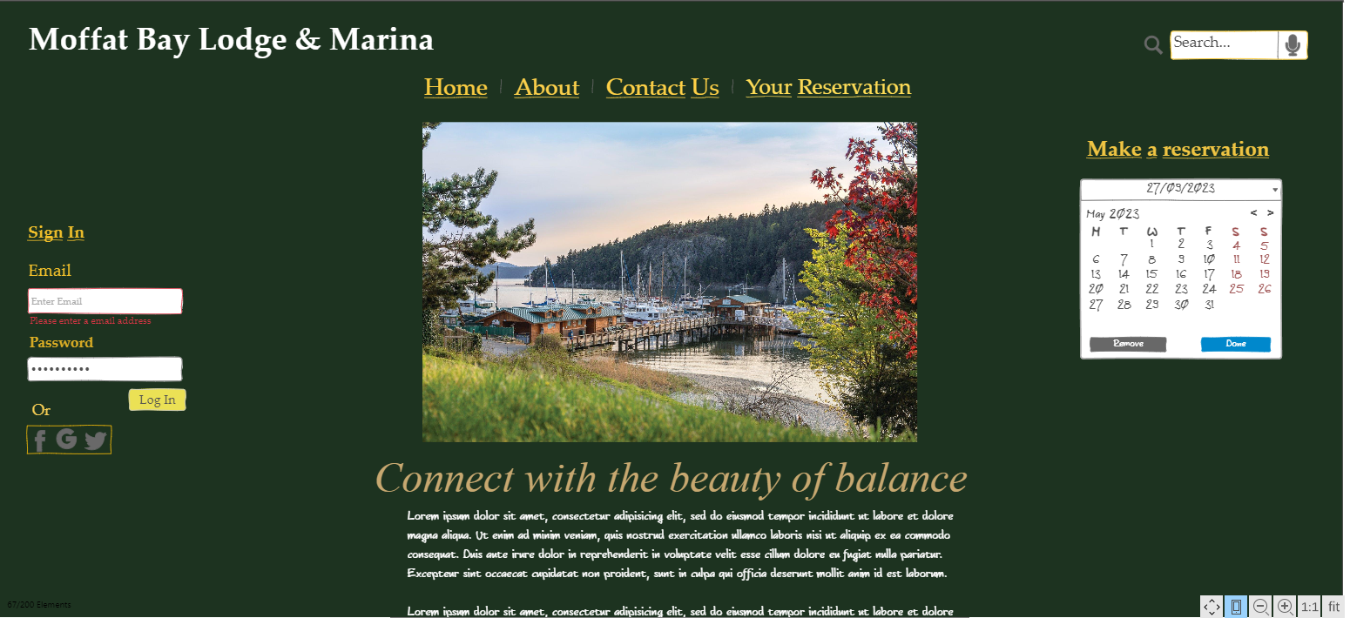
Prototypes and Mock-ups
This was the prototype for the landing page.
We maintained a similar layout.

Slide 9
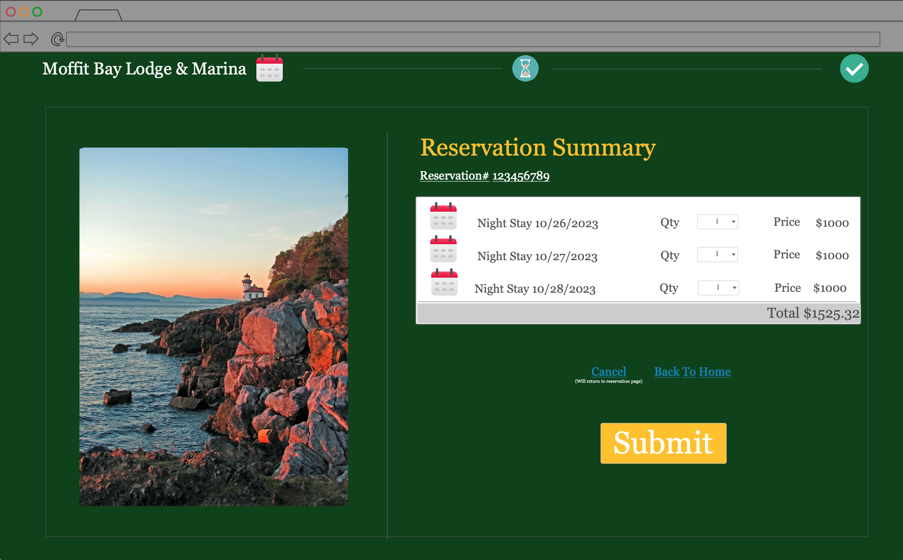
Prototypes and Mock-ups

Slide 10
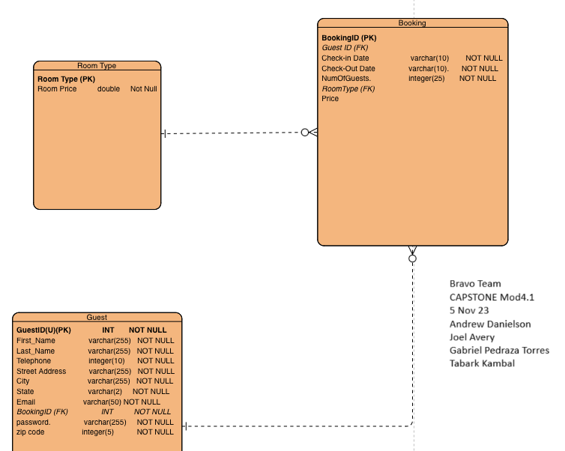
Entity Relationship Diagram

Slide 11
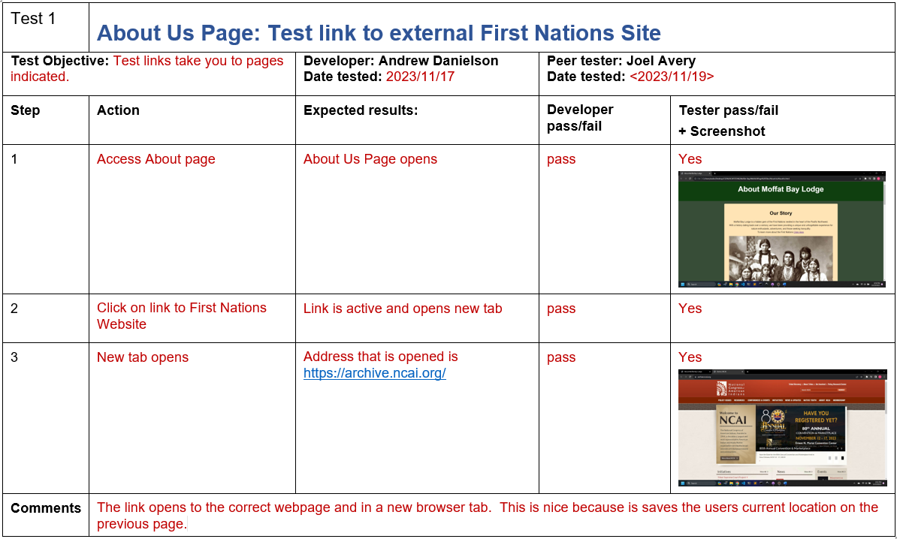
Test

Slide 12
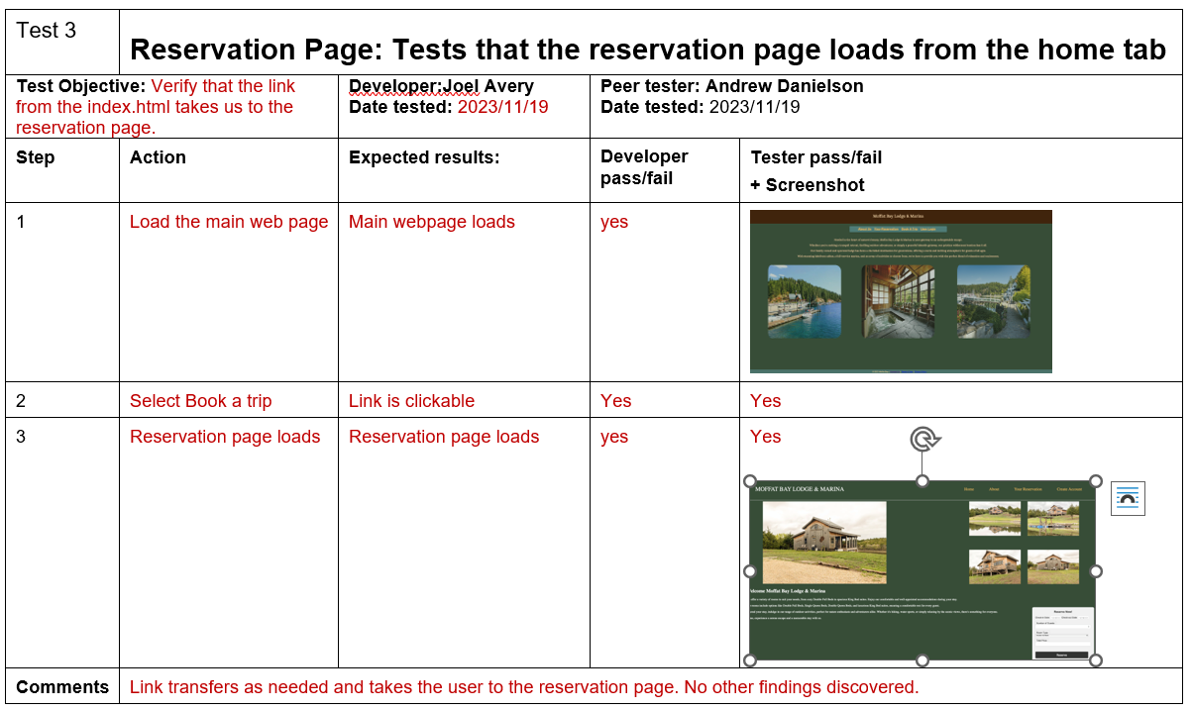
Test

Slide 13
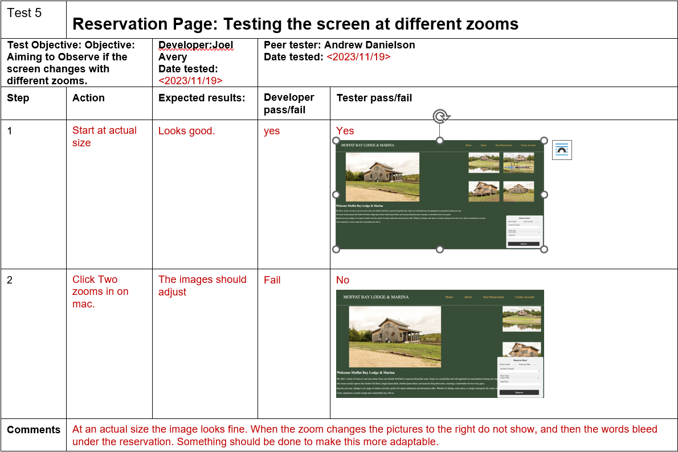
Test

Slide 14
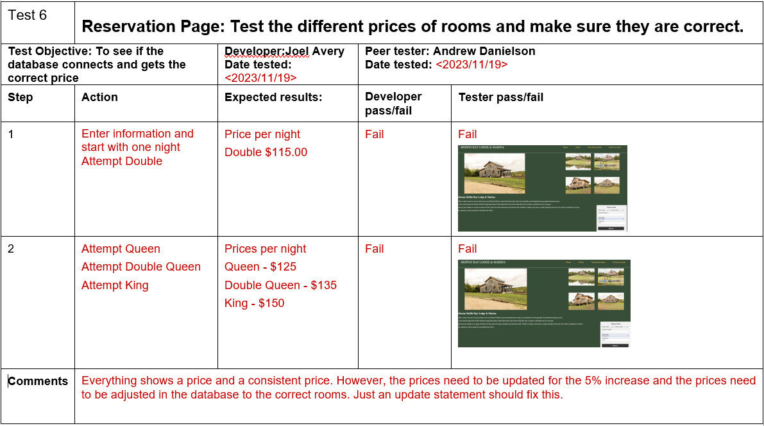
Test

Slide 15
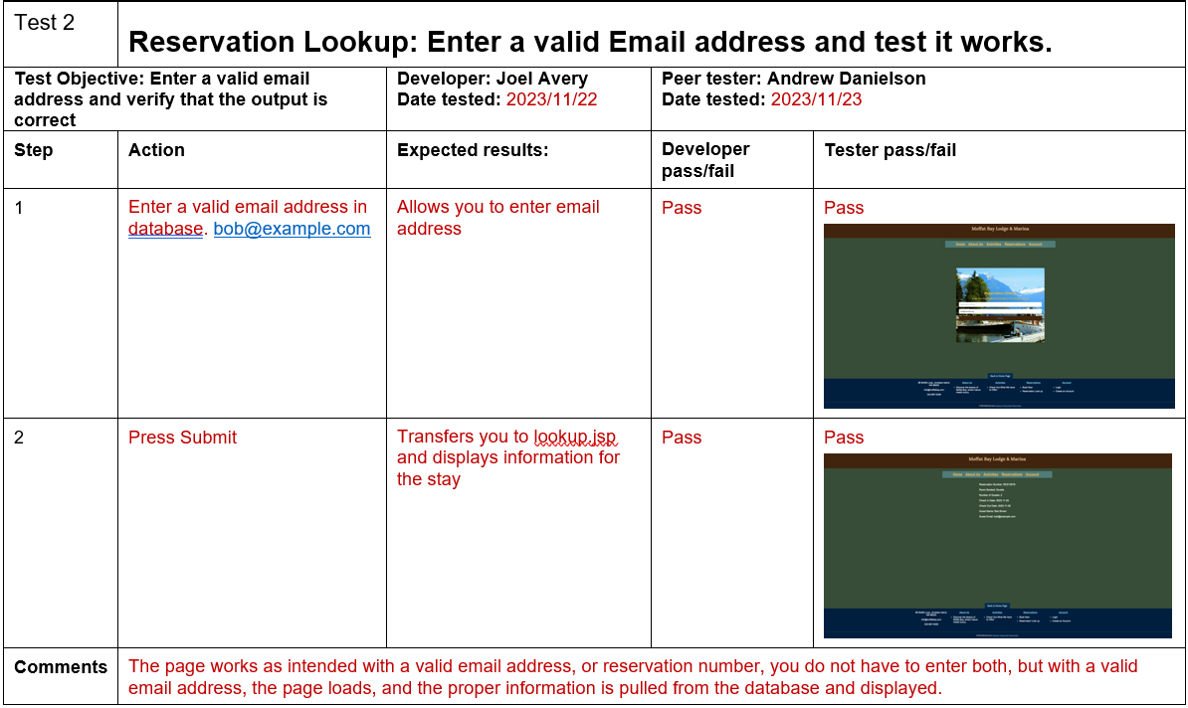
Test

Slide 16

Lessons Learned
Have a meeting early, not just using a message board.
Consistent code formatting
Repository set up and formatting
File location
Use of same software
Consistently push changes to repository
Create a branch if unsure of the changes

